Slide 1
System analysis project
_______________________
Travel company

Slide 2
Travel project
____________________________
The disadvantages of the old system.
1- wasting the time of the customers
2- wasting the efforts of the customers
3- There are large number of papers which may be lost
4- data customers and employees may be lost

Slide 3
Travel project
____________________________
The project objective
This project for company organized travel.
To offer others offer from different
Company.

Slide 4
Travel project
____________________________
The project team
1. Sadawy: collect data, system analyst, infra structure, programmer
2 Khaled: collect project data, system analyst
3 Sayed: collect data, system analyst

Slide 5
Travel project
____________________________
The project services
This project will help the customers
To booking the travels on line during the web and provided the time and the efforts of the customers
there are security in customers and employees data.

Slide 6
Travel project
____________________________
Step of improvement :-
1- Analysis phases.
2-Design phases

Slide 7
Travel project
____________________________
Analysis Phases:-
1-system request
2-feasability analysis
3-work plane.

Slide 8
system request
System analysis and design project
system request
Project is accompany for organize travails the name of the company is "international travails company"
project sponsor
sayed kamel is the project sponsor he is a manager of theone of big company of travels
Telephone:-0882422208
E-mail:
3- Business need
We want this project to improve and develops services of the travails organize
The time of the travails specialty of the every persons in this company and
Guides of this travails and the offers of the some company to provided the
Time meaning not wasting the time and make this development on the world
Wide web to faculties to the customers and it easier to the customers
4- Functionality
This project will be easy to use for the all customers it provided the time,
Efforts and money of the customers in any time itَ s be available for ()
For the all customers in any place in Egypt this travail are available for
Gropes and individual and organizations of teachers or employees and the
Company, the numbers of the customers will be increase in a few times
Because this faculties and good services

Slide 9
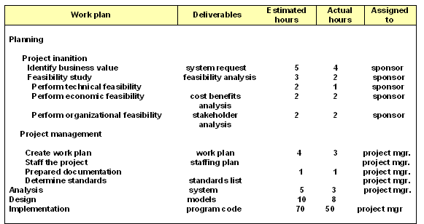
Travel project
____________________________
Work plane

Slide 10
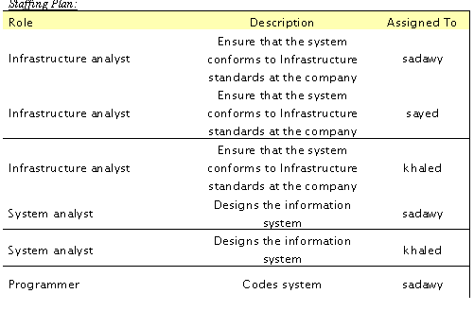
Travel project
____________________________

Slide 11
Travel project
____________________________
2-Design phases

Slide 12
Travel project
____________________________
Travel company project contains five
Processes:-
1- Customer order
2- Change the time of travel
3- Others offer
4- Change the destination of travel
5- Get any information about the travel

Slide 13
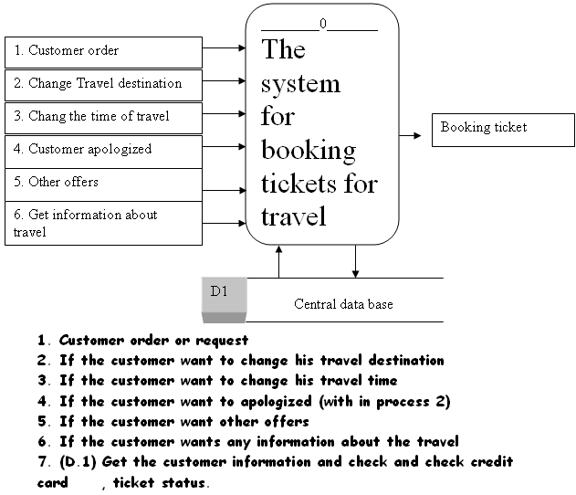
Travel project
____________________________

Slide 14
Travel project
____________________________
Logical process model

Slide 15
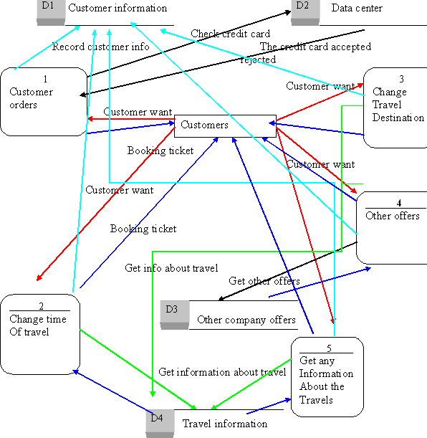
Travel project
____________________________

Slide 16
Travel project
____________________________
Physical process model

Slide 17
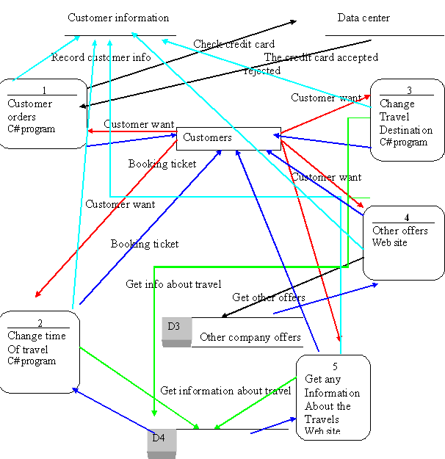

Slide 18
Travel project
____________________________
Level 1 of process

Slide 19
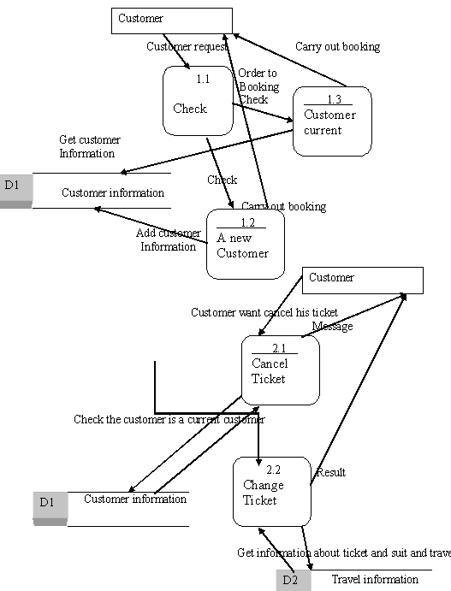

Slide 20
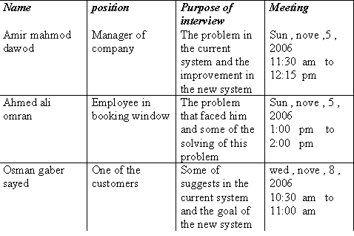
Travel project
____________________________
The interview schedule

Slide 21
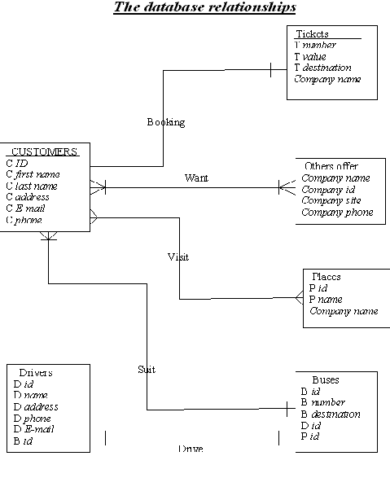
Travel project
____________________________

